Slide 1

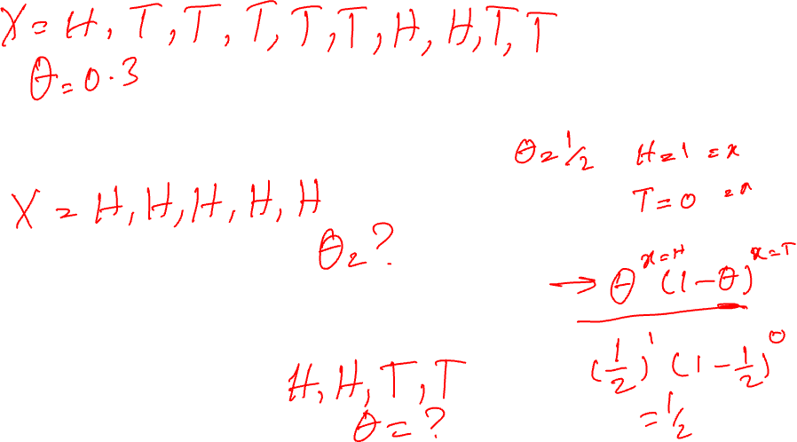
Bayesian Models
Payam Barnaghi
Department of Brain Sciences &
School of Convergence Science in Human and Artificial Intelligence
Imperial College London
January 2025
Notes:
1

Slide 2
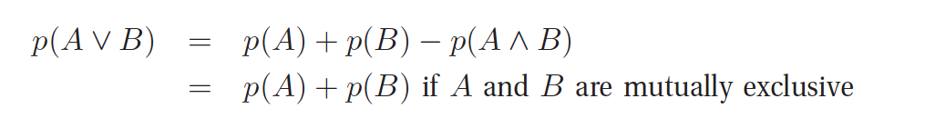
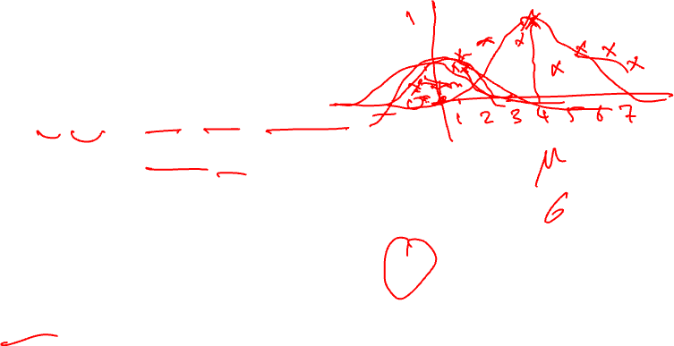
Probability of a union of two events
Given two events, A and B, we define the probability of A or B as follows:
A
B
A
B

Slide 3
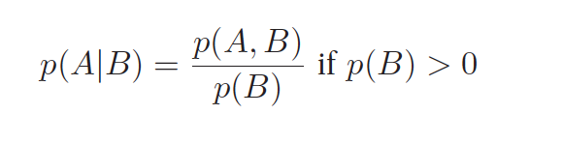

Conditional probability
We define the conditional probability of event A, given that event B is true, as follows:
A
B
p(A,B)

Slide 4
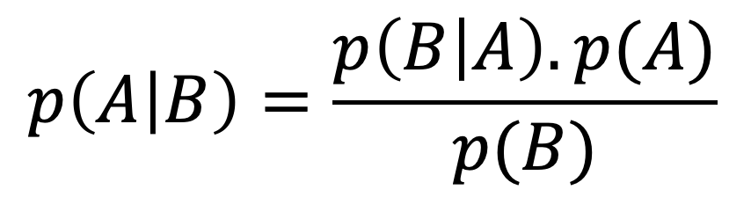
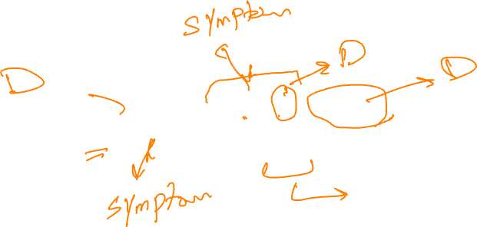
The Bayes rule
Likelihood
Prior
Posterior
$$p\left(A | B\right)=\frac{p\left(B | A\right). p(A)}{p(B)}$$
Marginalisation

Slide 5
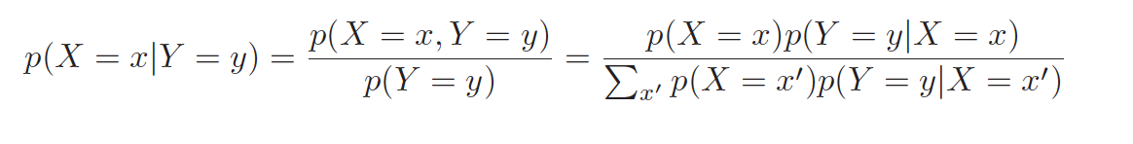
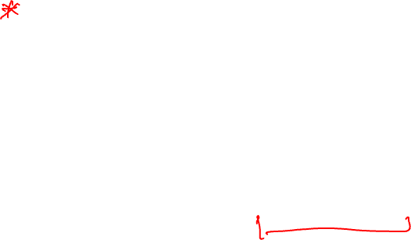
Bayes theorem
Combining the definition of conditional probability with the product and sum rules yields the Bayes rule, also called the Bayes theorem:

Slide 6

Bayesian Classification
Naive Bayes classifiers are built on Bayesian classification methods.
These rely on Bayes's theorem, which describes the relationship of conditional probabilities of statistical quantities.
In Bayesian classification, we are interested in finding the probability of a label given some observed features, which we can write as P( label | features).
Source: Python Data Science Handbook by Jake VanderPlas.

Slide 7
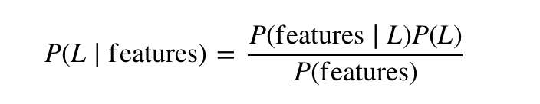
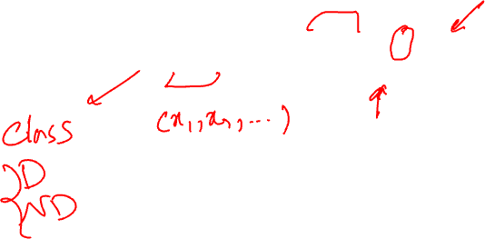
Naïve Bayes
We call it Naïve because it assumes that all the features are independent. In practice, this is not always true – but this assumption allows us to apply the Bayesian theorem:

Slide 8
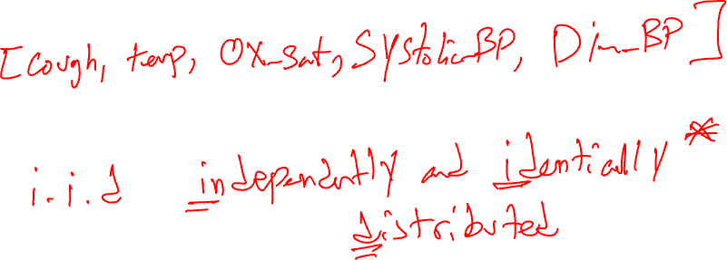
Assumptions in Naïve Bayes
We assume that the features are:
Independent given the outcome
The assumption is not correct in the real world, but the models we can build can often be useful in real-world practice (obviously with caution).

Slide 9
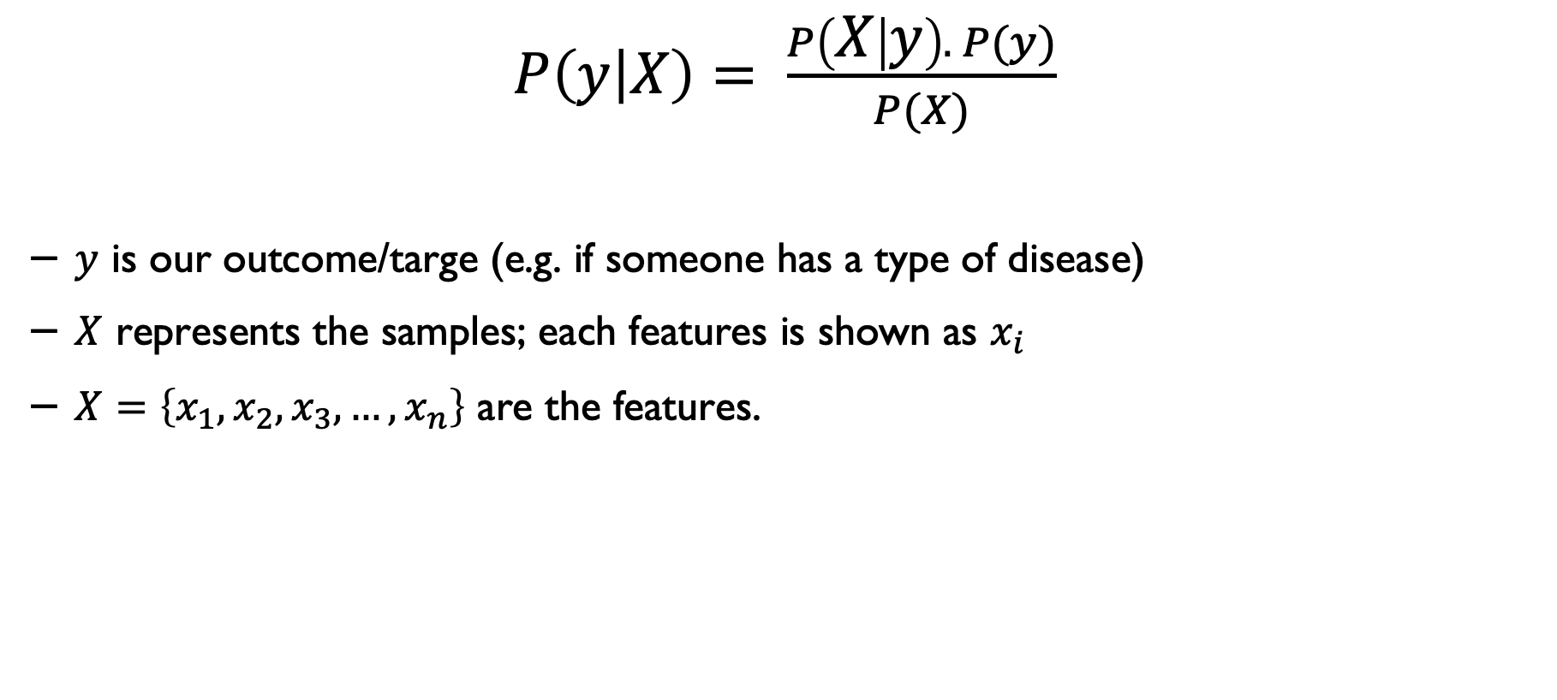
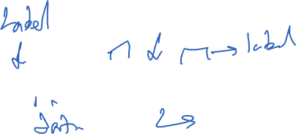
Bayes rule
$P\left(y | X\right)= \frac{P\left(X | y\right). P(y)}{P(X)}$
$y$ is our outcome/targe (e.g. if someone has a type of disease)
$X$ represents the samples; each features is shown as $x_{i}$
$X=\left\{x_{1},x_{2},x_{3}, …,x_{n}\right\}$ are the features.

Slide 10
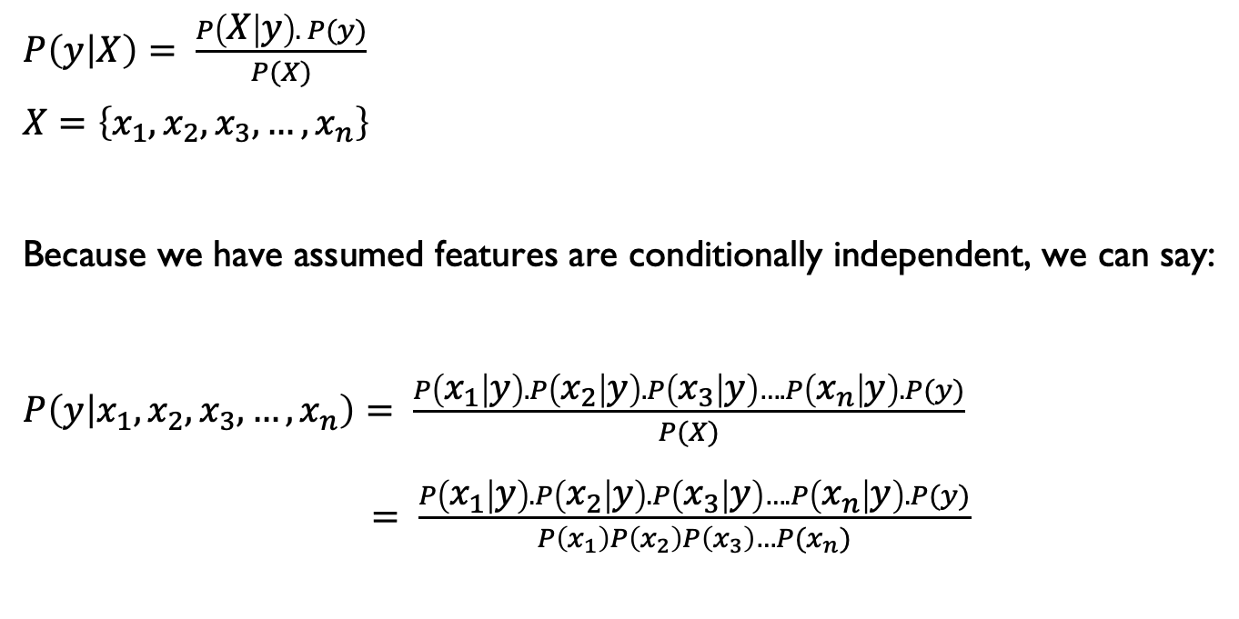
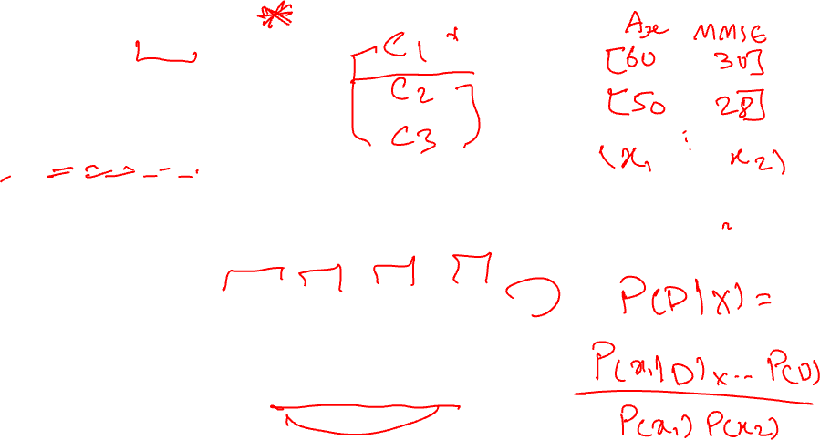
Determining Naïve Bayes
$P\left(y | X\right)= \frac{P\left(X | y\right). P(y)}{P(X)}$
$$X=\left\{x_{1},x_{2},x_{3}, …,x_{n}\right\}$$
Because we have assumed features are conditionally independent, we can say:
$P\left(y | x_{1},x_{2},x_{3}, …,x_{n}\right)= \frac{P\left(x_{1} | y\right).P\left(x_{2} | y\right).P\left(x_{3} | y\right)….P\left(x_{n} | y\right).P(y)}{P(X)}$
$= \frac{P\left(x_{1} | y\right).P\left(x_{2} | y\right).P\left(x_{3} | y\right)….P\left(x_{n} | y\right).P(y)}{P\left(x_{1}\right)P\left(x_{2}\right)P\left(x_{3}\right)…P(x_{n})}$

Slide 11
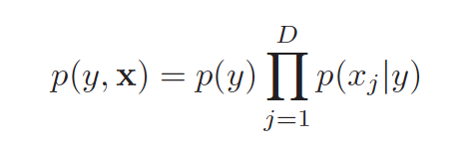
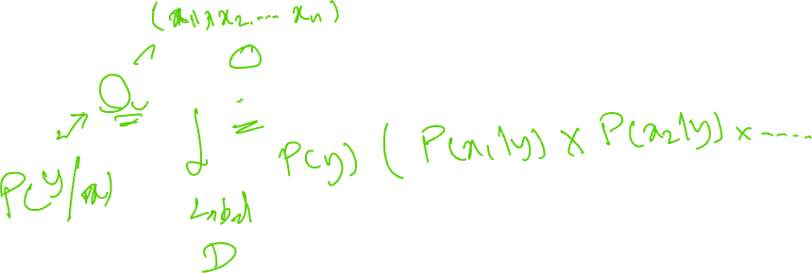
Let’s simplify

Slide 12
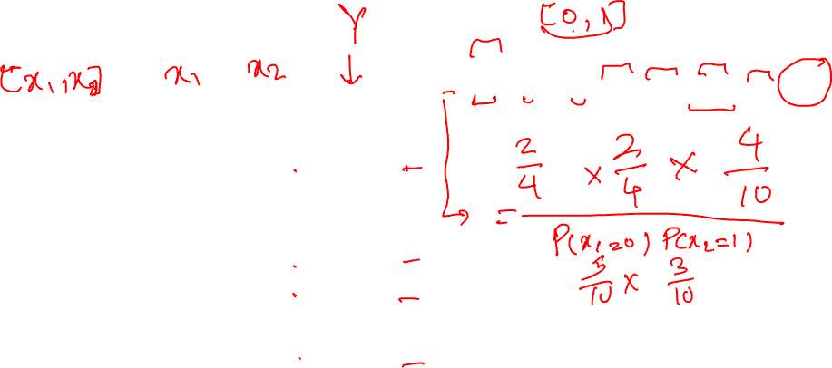
Naïve Bayes: example
P (disease =1) given [0,1]:
High BP
TBI
Disease
Patient #01 | 1 | 0 | 0
Patient #02 | 1 | 1 | 1
Patient #03 | 1 | 0 | 0
Patient #04 | 0 | 0 | 0
Patient #05 | 1 | 0 | 1
Patient #06 | 0 | 0 | 1
Patient #07 | 0 | 0 | 0
Patient #08 | 0 | 1 | 1
Patient #09 | 0 | 1 | 0
Patient #10 | 1 | 0 | 0
TBI: History of Traumatic Brain Injury; BP: Bloop Pressure

Slide 13
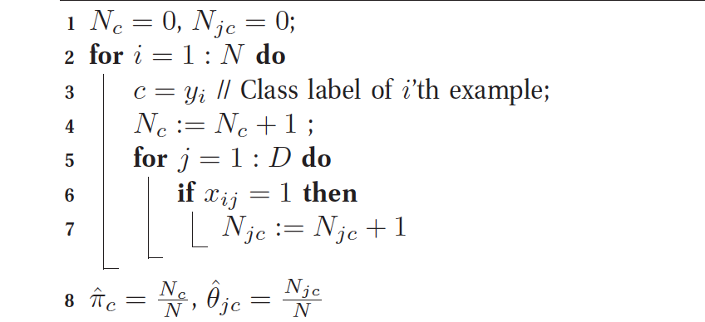
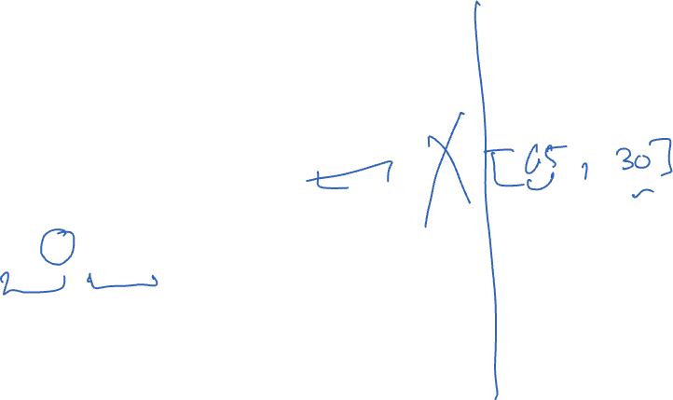
Algorithm for Naïve Bayes (with binary features)

Slide 14

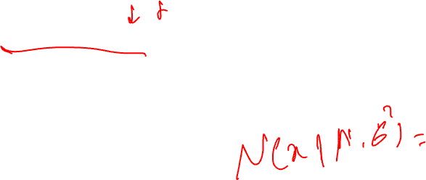
What about continuous variables?
In the case of real-valued features, we can use the Gaussian distribution:

Slide 15

Bayesian decision methods
Suppose we have an input vector x with a corresponding vector y of target variables.
Our goal is to predict y given a new value for x.
For a regression problem, y will contain continuous (real-valued) variables, and for a classification problem, y will represent class labels.

Slide 16
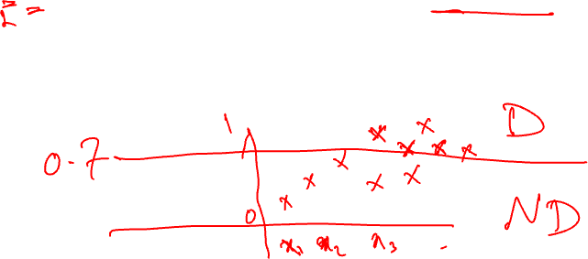
Joint probability
The joint probability distribution p(x,y) provides a summary of the uncertainty associated with these variables.
Determining p(x,y) from a set of training data is also referred to as inference.
Consider a medical diagnosis example: We have taken an MRI scan of a patient to determine whether the patient has a particular type of neurological disorder.

Slide 17

Medical diagnosis example
In the previous example, the input vector x is the set of pixels (or engineered features) from the scan.
y will represent the presence of the disease; for the presence of the disease, we show it, for example, with C₁, and for the absence of the disease, we note it as C_{2.}
The general inference problem then involves determining the join distribution p(x, C_{k})

Slide 18
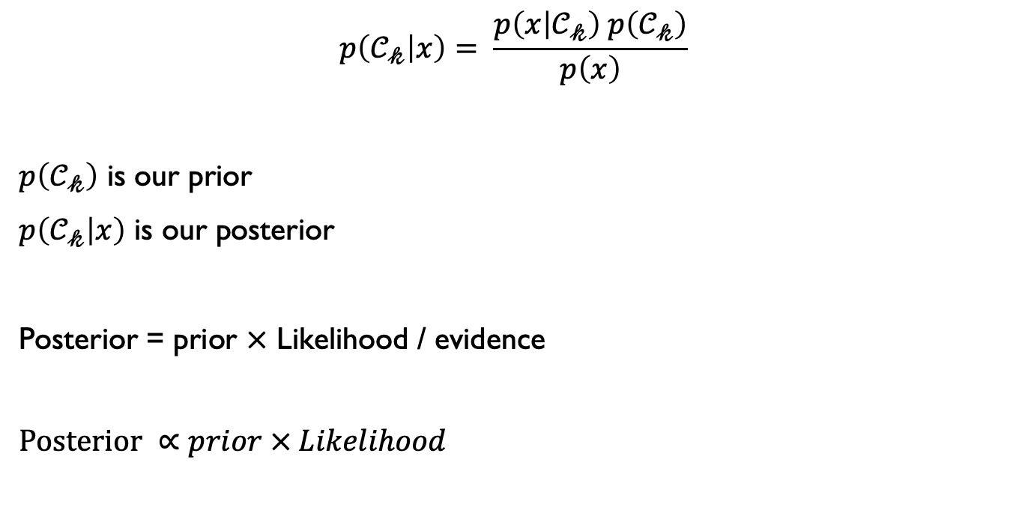
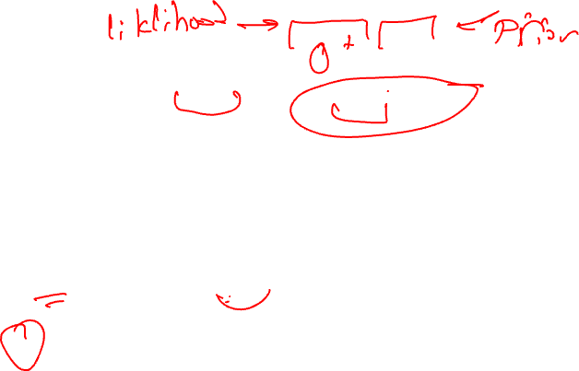
Example- applying Bayesian theorem
$$p\left(𝒞_{𝓀} | x\right)= \frac{p\left(x | 𝒞_{𝓀}\right) p\left(𝒞_{𝓀}\right)}{p\left(x\right)}$$
$p\left(𝒞_{𝓀}\right)$ is our prior
$p\left(𝒞_{𝓀} | x\right)$ is our posterior
Posterior = prior $×$ Likelihood / evidence
$$Posterior ∝prior × Likelihood$$

Slide 19
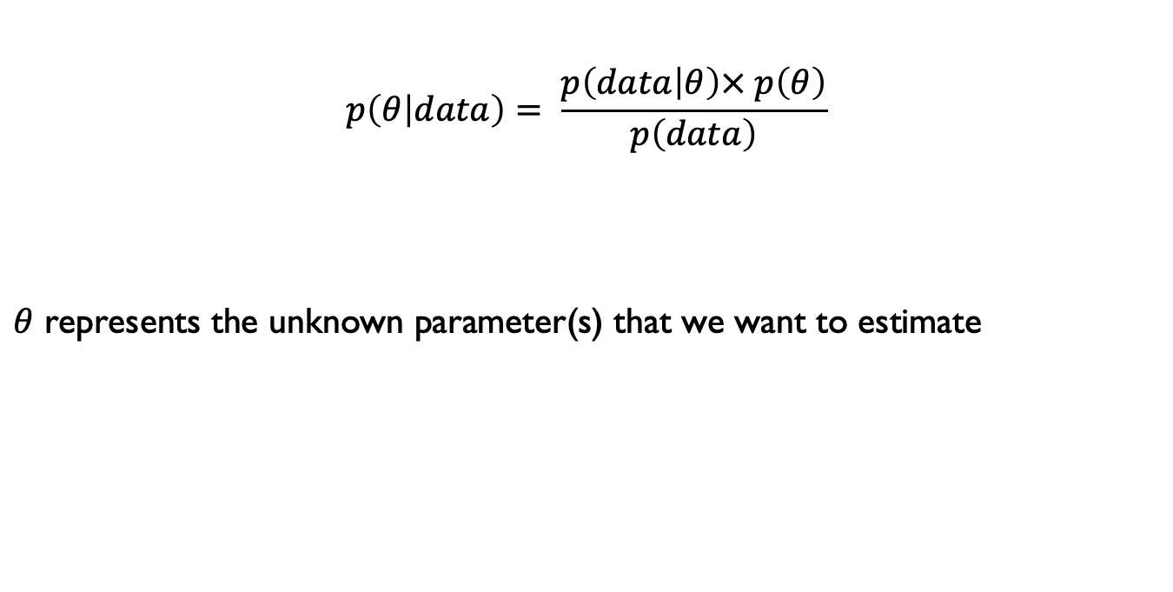
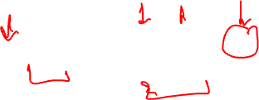
Bayesian inference
$$p\left(θ | data\right)= \frac{p\left(data | θ\right)× p\left(θ\right)}{p\left(data\right)}$$
$θ$ represents the unknown parameter(s) that we want to estimate

Slide 20
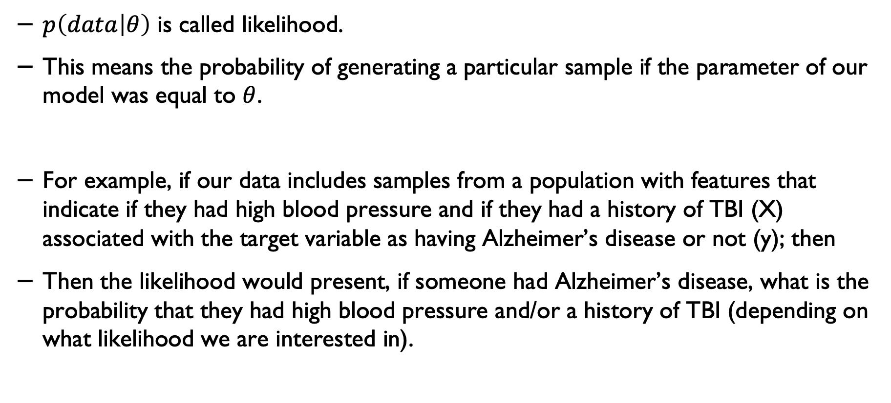
Likelihood
$p\left(data | θ\right)$ is called likelihood.
This means the probability of generating a particular sample if the parameter of our model was equal to $θ$.
For example, if our data includes samples from a population with features that indicate if they had high blood pressure and if they had a history of TBI (X) associated with the target variable as having Alzheimer’s disease or not (y); then
Then the likelihood would present, if someone had Alzheimer’s disease, what is the probability that they had high blood pressure and/or a history of TBI (depending on what likelihood we are interested in).

Slide 21

Maximum likelihood*
In principle, we define the likelihood function and then try to calculate the parameter values that maximise the likelihood of obtaining our data.
In other words, in the previous example, p(data│θ), we assumed that we know the parameter θ, but what if we try to use a method to identify what value(s) for θ would maximise the likelihood of obtaining the data?
For example, in the case of a disease, we may not know the prevalence of the disease in advance in the population.

Slide 22
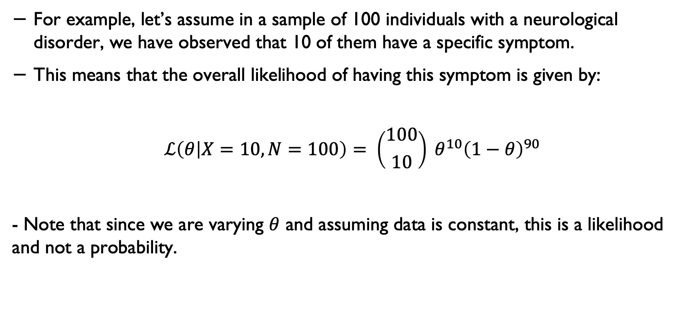

Estimating the maximum likelihood*
For example, let’s assume in a sample of 100 individuals with a neurological disorder, we have observed that 10 of them have a specific symptom.
This means that the overall likelihood of having this symptom is given by:
$$ℒ\left(θ | X=10, N=100\right)= \left({100 \atop 10}\right) θ^{10}{\left(1−θ\right)}^{90}$$
- Note that since we are varying $θ$ and assuming data is constant, this is a likelihood and not a probability.

Slide 23
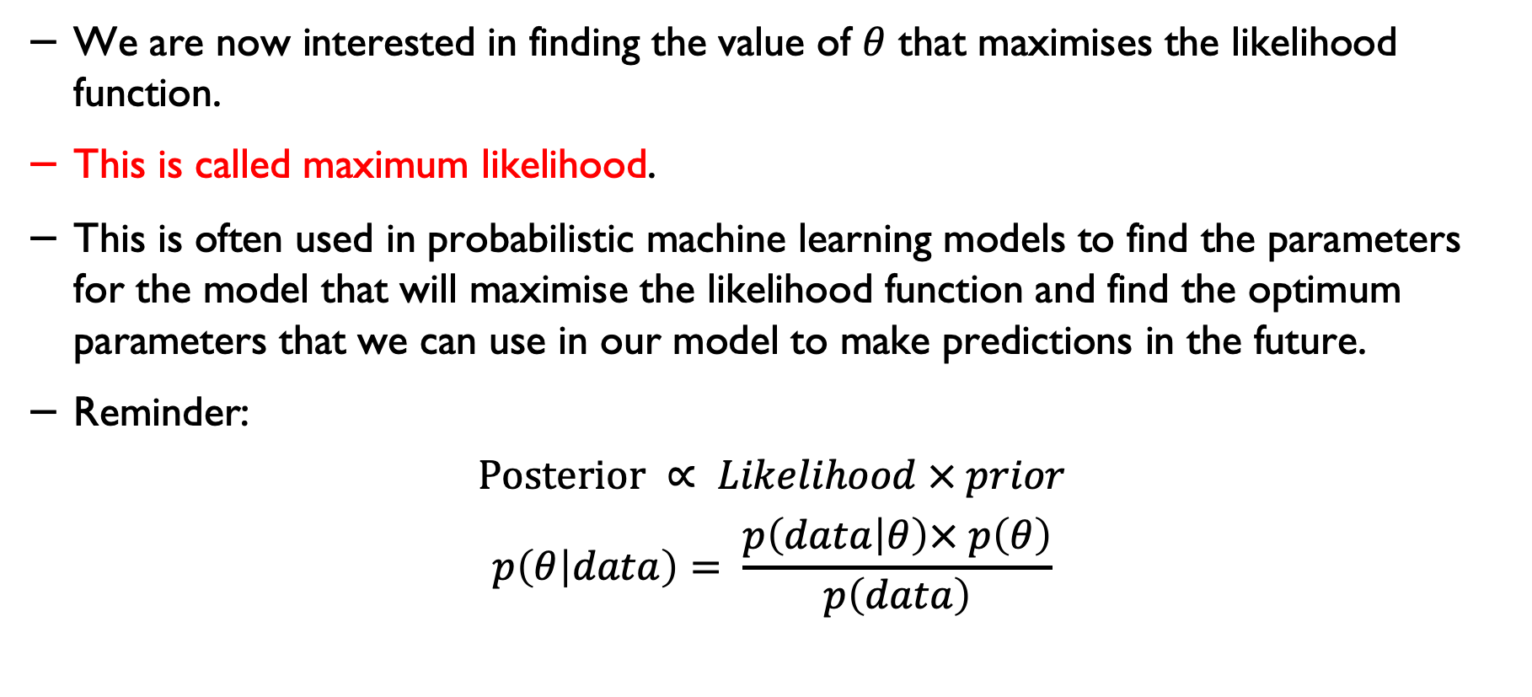

Estimating the maximum likelihood*
We are now interested in finding the value of $θ$ that maximises the likelihood function.
This is called maximum likelihood.
This is often used in probabilistic machine learning models to find the parameters for the model that will maximise the likelihood function and find the optimum parameters that we can use in our model to make predictions in the future.
Reminder:
$$Posterior ∝ Likelihood × prior$$
$$p\left(θ | data\right)= \frac{p\left(data | θ\right)× p\left(θ\right)}{p\left(data\right)}$$

Slide 24
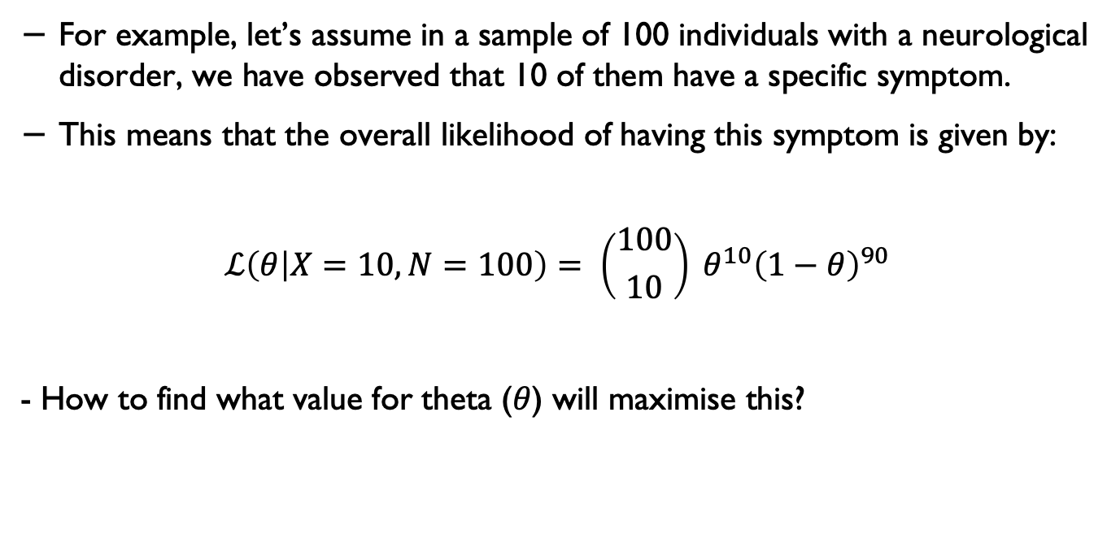
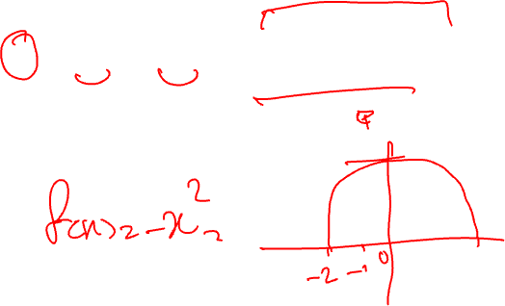
Repeating our example*
For example, let’s assume in a sample of 100 individuals with a neurological disorder, we have observed that 10 of them have a specific symptom.
This means that the overall likelihood of having this symptom is given by:
$$ℒ\left(θ | X=10, N=100\right)= \left({100 \atop 10}\right) θ^{10}{\left(1−θ\right)}^{90}$$
- How to find what value for theta ($θ$) will maximise this?

Slide 25
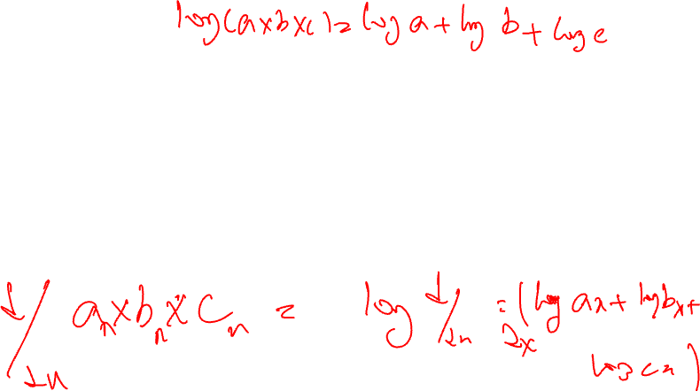
Log likelihood*
Before we continue with the next few slides:
I don’t expect you to know or use the maths discussed here- this is just added for your information and for those who might be interested in pursuing Bayesian methods further.
Most modern libraries will train/learn your model and optimise the parameters for you automatically, including the models we will use in our lab experiments.

Slide 26
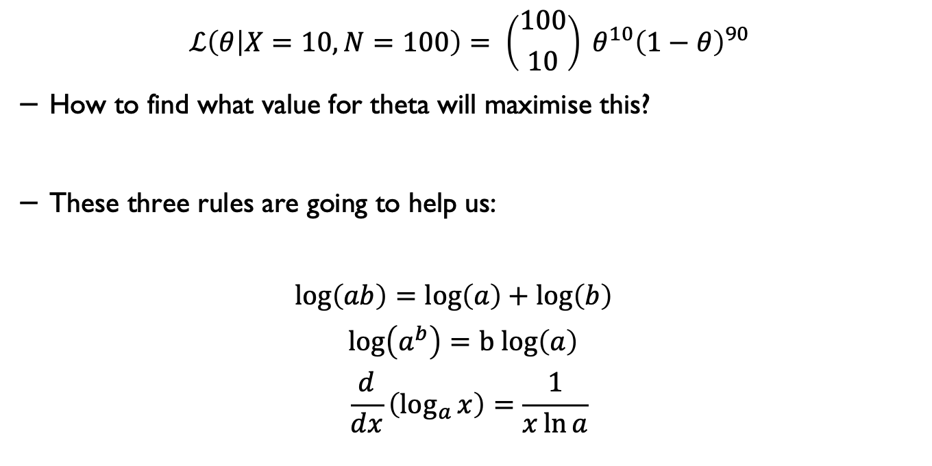
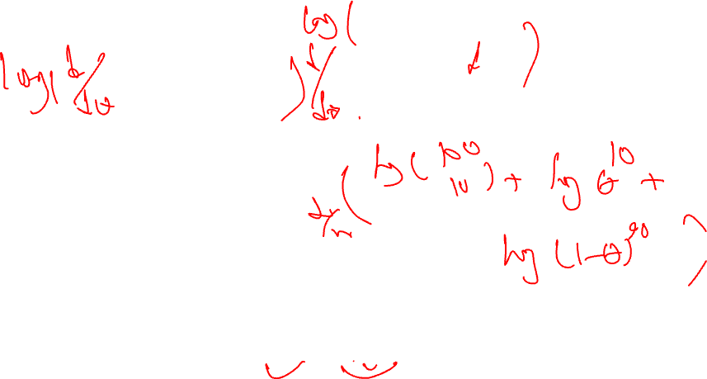
Log likelihood*
$$ℒ\left(θ | X=10, N=100\right)= \left({100 \atop 10}\right) θ^{10}{\left(1−θ\right)}^{90}$$
How to find what value for theta will maximise this?
These three rules are going to help us:
$$\log\left(ab\right)=\log\left(a\right)+\log\left(b\right)$$
$$\log\left(a^{b}\right)=b log\left(a\right)$$
$$\frac{d}{dx}\left(\log_{a}{x}\right)=\frac{1}{x\ln{a}}$$

Slide 27
Maximising the Log likelihood*
To maximise the likelihood, calculate log-likelihood, take the derivative and then set it equal to zero.
We calculate the log-likelihood for simplicity of working with sums (+) instead of multiplications (x) [needed for the step below]
We take the first derivative and set it to zero because the first derivative will give us the slope of change;
And setting it to zero will give you the point that the point that the function is maximised.

Slide 28
Why?
Why do we take the first derivative and set it to zero?

Slide 29
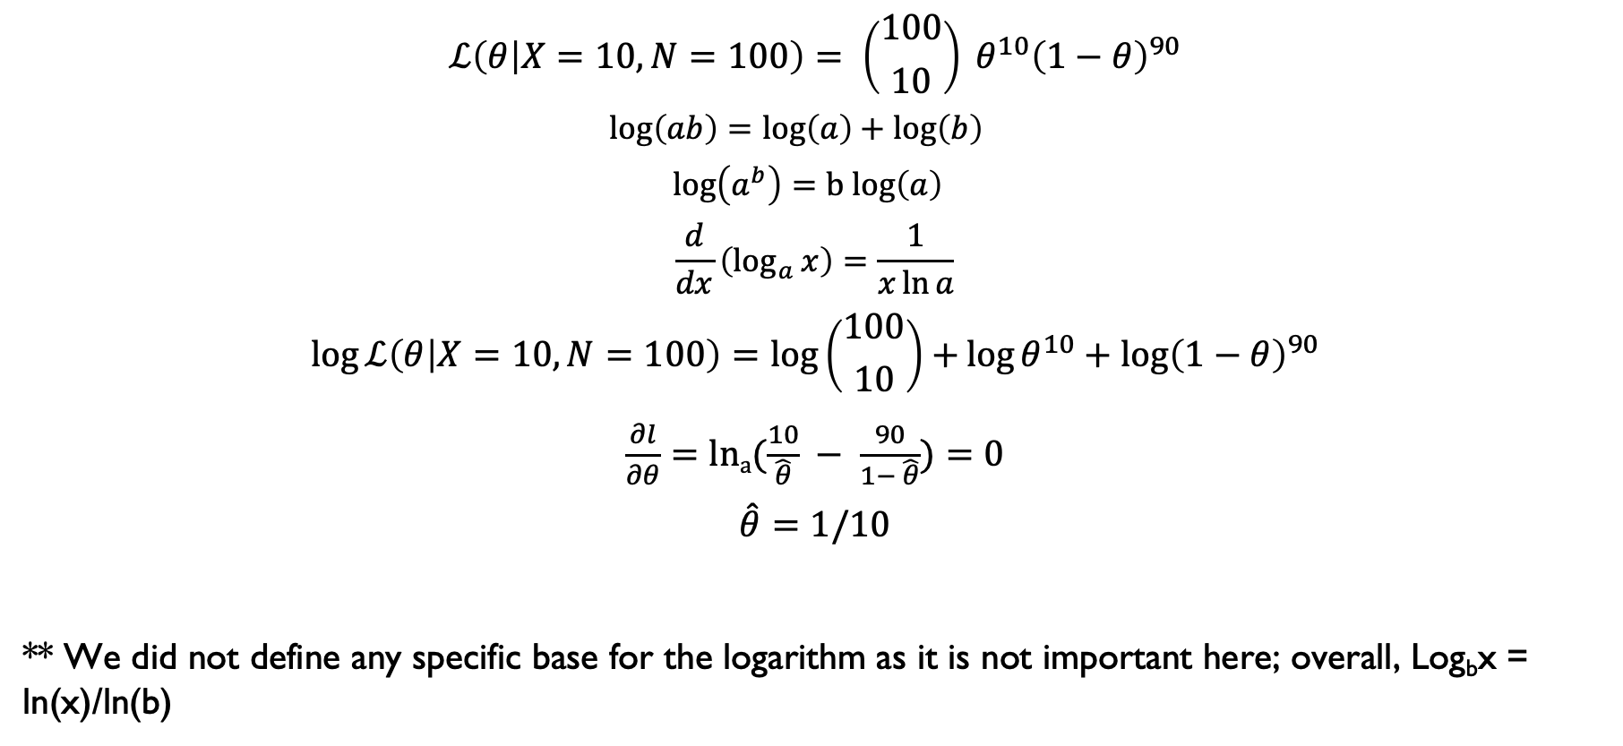
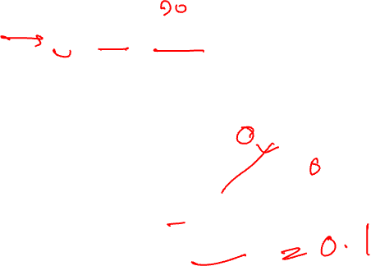
Maximising the Log likelihood*
$$ℒ\left(θ | X=10, N=100\right)= \left({100 \atop 10}\right) θ^{10}{\left(1−θ\right)}^{90}$$
$$\log\left(ab\right)=\log\left(a\right)+\log\left(b\right)$$
$$\log\left(a^{b}\right)=b log\left(a\right)$$
$$\frac{d}{dx}\left(\log_{a}{x}\right)=\frac{1}{x\ln{a}}$$
$$\log{ℒ\left(θ | X=10, N=100\right)}=\log\left({100 \atop 10}\right)+\log{θ^{10}+\log{{\left(1−θ\right)}^{90}}}$$
$\frac{∂l}{∂θ}=lna(\frac{10}{\hat{θ}} − \frac{90}{1− \hat{θ}})=0$
$$\hat{θ}=1/10$$
** We did not define any specific base for the logarithm as it is not important here; overall, Log_{b}x = ln(x)/ln(b)

Slide 30

Naïve Bayes in python
It required a small amount of training data to estimate the necessary parameters.
Naive Bayes learners and classifiers can be very fast compared to more sophisticated methods.
On the flip side, although naïve Bayes is known as a decent classifier, it is known to be a bad estimator, so the probability outputs from predict_proba (in Pythin scikit learn) are not to be taken too seriously.
Source: https://scikitlearn.org/stable/modules/naive_bayes.html

Slide 31
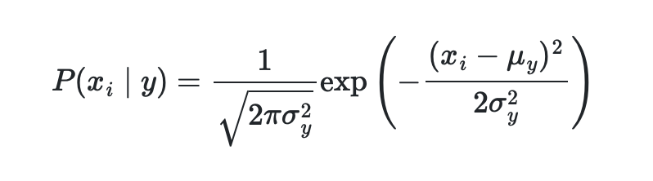

Naïve Bayes in python
Gaussian Naive Bayes:
GaussianNB implements the Gaussian Naive Bayes algorithm for classification. The likelihood of the features is assumed to be Gaussian:
The parameters σ_{y} and μ_{y} are estimated using maximum likelihood.
Source: https://scikitlearn.org/stable/modules/naive_bayes.html

Slide 32
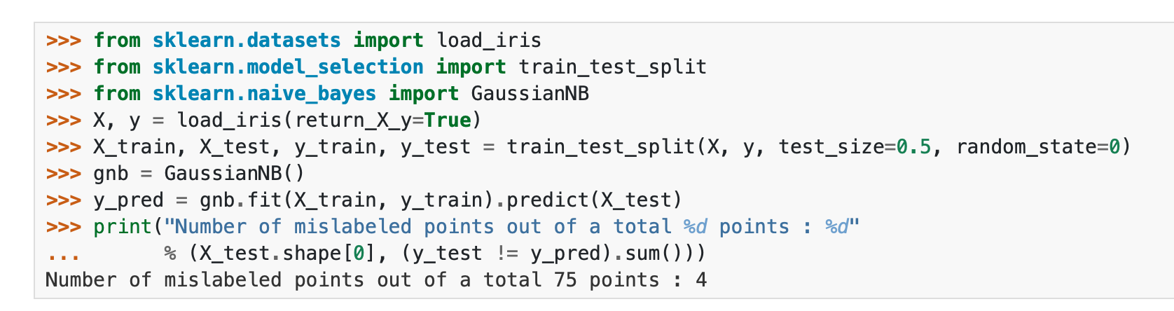
Gaussian Naive Bayes
Source: https://scikitlearn.org/stable/modules/naive_bayes.html

Slide 33

Multinomial Naïve Bayes
MultinomialNB implements the naïve Bayes algorithm for multinomially distributed data and is one of the two classic naïve Bayes variants used in text classification.
The distribution is parametrised by vectors θy=(θ_{y1},…,θ_{yn}) for each class y, where n is the number of features and θyi is the probability P(x_{i}∣y) of feature i appearing in a sample belonging to class y.
The parameters θy is estimated by a smoothed version of maximum likelihood, i.e. relative frequency counting:
Source: https://scikitlearn.org/stable/modules/naive_bayes.html

Slide 34
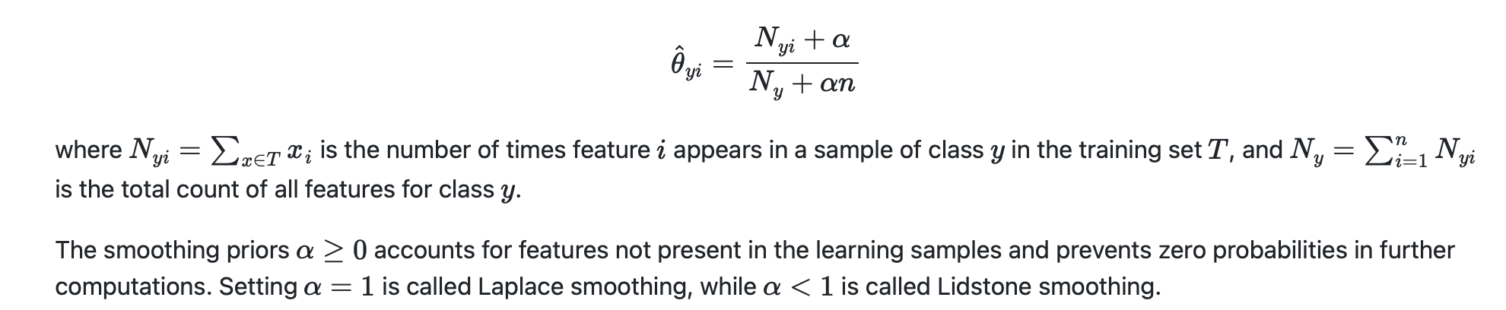
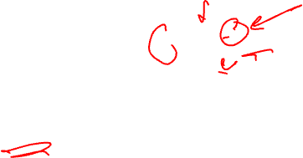
Multinomial Naïve Bayes*
The parameters θy is estimated by a smoothed version of maximum likelihood, i.e. relative frequency counting:
Source: https://scikitlearn.org/stable/modules/naive_bayes.html

Slide 35
Evaluation metrics

Slide 36
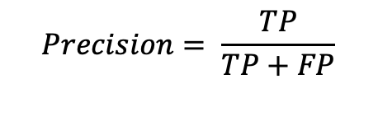
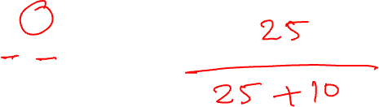
Precision and Recall
Precision defines what proportion of positive identifications have actually been correct.
TP = True Positive
FP = False Positive
$$Precision= \frac{TP}{TP+FP}$$
Example: Calculate the Precision
True Positives: 25 | False Positives: 10
False Negatives: 15 | True Negatives: 80

Slide 37

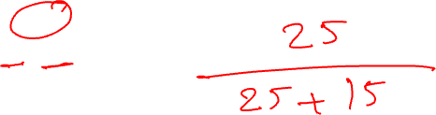
Recall
Recall defines the proportion of actual positives that were identified correctly.
TP = True Positive
FN = False Negative
$$Recall= \frac{TP}{TP+FN}$$
Example: Calculate the Recall
True Positives: 25 | False Positives: 10
False Negatives: 15 | True Negatives: 80

Slide 38
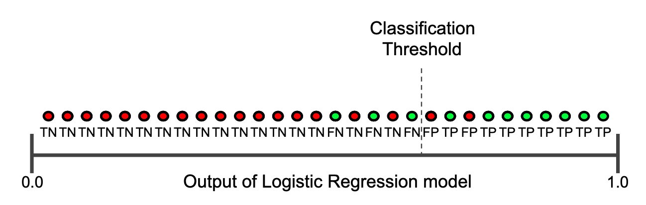
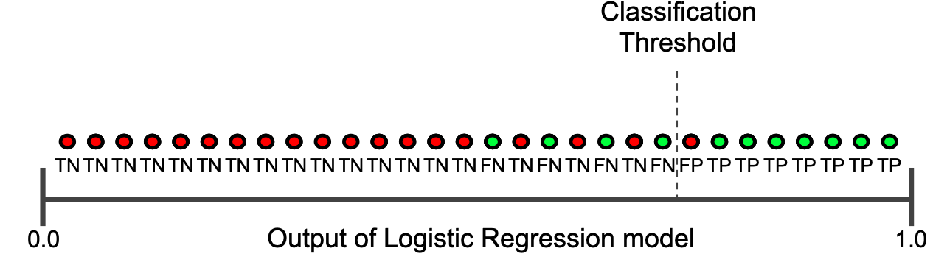
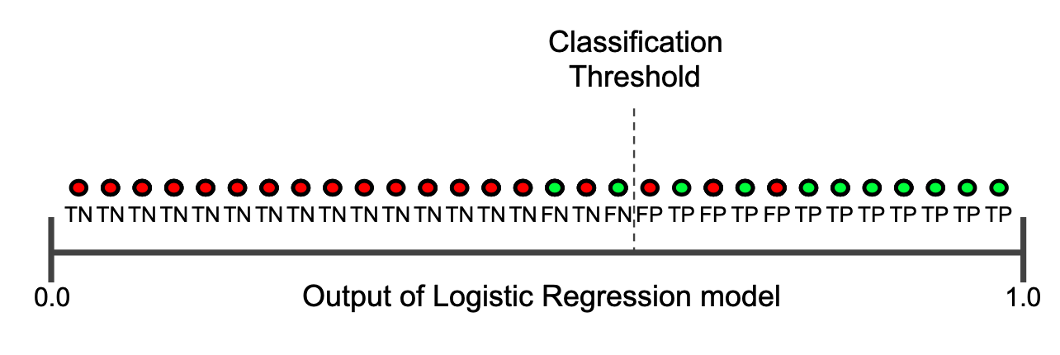
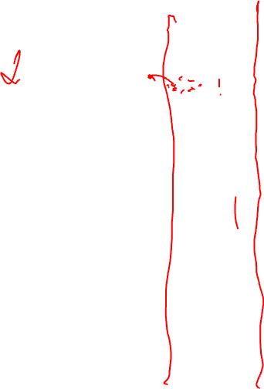
Precision and Recall
How decision threshold could affect Precision and Recall.
This can be very important in medical applications.
Image source: https://developers.google.com/machine-learning/crash-course/classification/precision-and-recall

Slide 39
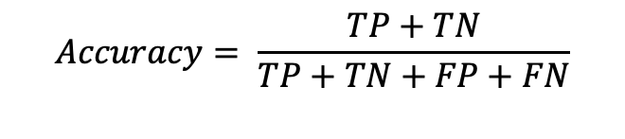
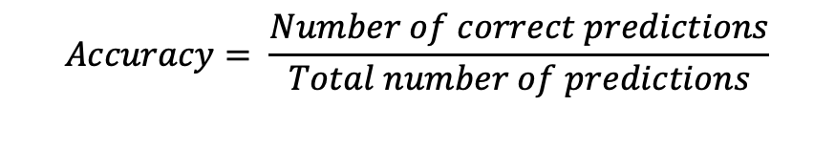

Accuracy
Accuracy is a metric to evaluate classification models.
It shows the fraction of predictions that the model has made correct predictions.
$$Accuracy= \frac{Number of correct predictions}{Total number of predictions}$$
$$Accuracy= \frac{TP+TN}{TP+TN+FP+FN}$$

Slide 40
Accuracy – how to interpret it
Accuracy could be a misleading metric without sufficient (other) complimentary information.
Imagine we have a model that has classified 100 tumours as malignant (the positive class) and benign (the negative class).
If someone tells you that the accuracy of the model is 91%; is that good?
source: https://developers.google.com/machine-learning/crash-course/classification/precision-and-recall

Slide 41
Accuracy interpretation example
Of the 100 tumour examples, 91 are benign (90 TNs and 1 FP) and 9 are malignant (1 TP and 8 FNs).
Of the 91 benign tumours, the model correctly identifies 90 as benign. That's good.
However, of the 9 malignant tumours, the model only correctly identifies 1 as malignant—not a good outcome, as 8 out of 9 malignancies go undiagnosed!
source: https://developers.google.com/machine-learning/crash-course/classification/precision-and-recall

Slide 42


F₁ Score
F₁ score is the harmonic mean of precision and recall.
$$F1=2 × \frac{Precision × Recall}{Precision +Recall}$$
Example: Calculate the F₁ score
True Positives: 25 | False Positives: 10
False Negatives: 15 | True Negatives: 80

Slide 43


ROC curve (receiver operating characteristic curve)
A ROC curve (receiver operating characteristic curve) is a graph showing the performance of a classification model at all classification thresholds. This curve plots two parameters:
True Positive Rate (TPR)
False Positive Rate (FPR)
Does this look familiar?
$$TPR= \frac{TP}{TP+FN}$$
source: https://developers.google.com/machine-learning/crash-course/classification/precision-and-recall

Slide 44


ROC curve
A ROC curve plots TPR vs. FPR at different classification thresholds. Lowering the classification threshold classifies more items as positive, thus increasing both False Positives and True Positives.
source: https://developers.google.com/machine-learning/crash-course/classification/precision-and-recall

Slide 45


AUC: Area Under the ROC Curve
AUC stands for "Area under the ROC Curve."
AUC measures the entire two-dimensional area underneath the entire ROC curve.
AUC provides an aggregate measure of performance across all possible classification thresholds.
Please note that there is also an AUC for Precision-Recall Curve
source: https://developers.google.com/machine-learning/crash-course/classification/precision-and-recall

Slide 46
PR AUC vs ROC AUC
- PR AUC:
Evaluating performance based on positive class
Better suited for imbalanced data,
Precision vs. Recall
- ROC AUC:
Evaluating overall classification performance,
It can be misleading for imbalanced data,
TPR vs. FPR

Slide 47

Cases that AUC could be useful
AUC is desirable for the following two reasons:
AUC is scale-invariant. It measures how well predictions are ranked rather than their absolute values.
AUC is classification-threshold invariant. It measures the quality of the model's predictions regardless of the classification threshold chosen.
source: https://developers.google.com/machine-learning/crash-course/classification/precision-and-recall

Slide 48
Cases that AUC will NOT be useful
Scale invariance is not always desirable. For example, sometimes, we really do need well-calibrated probability outputs, and AUC won’t tell us about that.
Classification-threshold invariance is not always desirable. In cases where there are wide disparities in the cost of false negatives vs. false positives, it may be critical to minimise one type of classification error. For example, in a medical test that FPs and FNs do not carry equal weights. AUC isn't a useful metric for this type of optimisation.
source: https://developers.google.com/machine-learning/crash-course/classification/precision-and-recall

Slide 49


Prediction bias
Some of the reasons:
The training set doesn't adequately represent certain subsets of the data space.
Some subsets of the data set are noisier than others.
The model is overly regularised.
It can also be determined as:
$$Prediction bias=average of predictions −average of labels$$

Slide 50



Sensitivity and specificity
Sensitivity: the ability of a test to correctly identify patients with a disease.
Specificity: the ability of a test to correctly identify people without the disease.
Prevalence: the percentage of people in a population who have the condition of interest.
$$Sensetivity= \frac{TP}{TP+FN}$$
$$Specificity= \frac{TN}{TN+FP}$$
Source: Swift A, Heale R, Twycross A, What are sensitivity and specificity?, Evidence-Based Nursing 2020;23:2-4.

Slide 51



Sensitivity/Specificity: Example
$$Sensetivity= \frac{TP}{TP+FN}$$
$$Specificity= \frac{TN}{TN+FP}$$
Example: Calculate the sensitivity and specificity
True Positives: 25 | False Positives: 10
False Negatives: 15 | True Negatives: 80

Slide 52


Specificity and Sensitivity
Source: https://en.wikipedia.org/wiki/Sensitivity_and_specificity

Slide 53


Confusion matrix

Slide 54



Youden’s index
Captures the “informedness” measure..
The classification thresholds can be selected to maximise informedness.
$$J= Sensetivity+Specificity −1$$
Solid red: ROC curve; Dashed line: Chance level; Vertical line (J) maximum value of Youden's index for the ROC
Source: https://en.wikipedia.org/wiki/Youden%27s_J_statistic

Slide 55

Probability calibration
Sometimes, in classification, you may want to predict the class label as well as the probability of the label for that class.
This probability will provide an estimate/measure of the prediction.
You need to be aware that some models can give poor estimates of the class probabilities (e.g. Naïve Bayes).
Calibrating a classifier consists of fitting a regressor (called a calibrator) that maps the output of the classifier to a calibrated probability in [0, 1].
Denoting the output of the classifier for a given sample by f_{i}, the calibrator tries to predict p(y_{i}=1|f_{i}).
See: https://scikit-learn.org/stable/modules/calibration.html

Slide 56





All in one place
$$Precision= \frac{TP}{TP+FP}$$
$$F1=2 × \frac{Precision × Recall}{Precision +Recall}$$
$$Recall= \frac{TP}{TP+FN}$$
$$Accuracy= \frac{TP+TN}{TP+TN+FP+FN}$$
$$Sensetivity= \frac{TP}{TP+FN}$$
$$Specificity= \frac{TN}{TN+FP}$$

Slide 57
Review Questions

Slide 58
Q1
Imagine you come across a model for which its accuracy is specified as 91%; is that good?
menti code will be provided.

Slide 59
Q2
Imagine you are developing a screening tool for the risk of Alzheimer's disease using electronic healthcare records (EHR) data. You will implement an ML model to process historical medical records. Which metric will give you a higher weight (if any)?

Slide 60
Metric in Scikit-learn
Metrics and scoring:
https://scikit-learn.org/stable/modules/model_evaluation.html#confusion-matrix

Slide 61
Acknowledgments
The slides on likelihood estimation are adapted from “A student’s guide to Bayesian Statistics) by Ben Lambert, SAGE, 2019.
Some of the slides on Bayesian models and equations are adapted from Kevin Murphy’s book:
Machine Learning: A Probabilistic Perspective Kevin P. Murphy, MIT Press.

Slide 62
If you have any questions
Please feel free to arrange a meeting or email (p.barnaghi@imperial.ac.uk).
My office: 928, Sir Michael Uren Research Hub, White City Campus.

